Slide 1
API Testing

Slide 2
API
API is an acronym and it stands for Application Programming Interface. API is a set of routines, protocols, and tools for building Software Applications. APIs specify how one software program should interact with other software programs.

Slide 3
How It Works
API gets the request from the user and gives the response without exposing internal logic. API acts like an Abstraction in OOPs concept.

Slide 4
errors
400 BAD REQUEST – Generic error that is returned when no other 4xx status code is appropriate. Domain validation errors, missing data and improper API requests are some examples.
401 UNAUTHORIZED – Error code response for missing or invalid authentication token.
403 FORBIDDEN – Error code response when the user is not authorized to perform the operation
404 NOT FOUND – Used when the requested resource is not found, it doesn’t exist or if there was a 401 or 403 error and for security reasons, the service masks it as a 404 error
409 CONFLICT – Response for resource conflicts, for example, duplicate entries are found or trying to delete root objects when cascade-delete is not supported
500 INTERNAL SERVER ERROR – This error code is returned when the consumer cannot identify the exact error from their end. It is a general catch-all error when the server-side throws an exception.

Slide 5
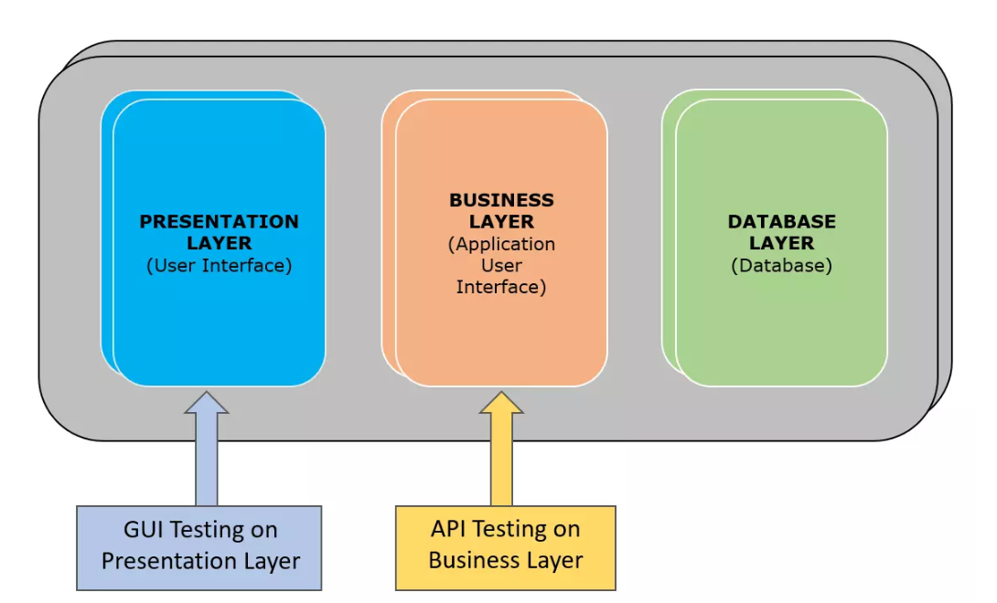
what is API testing

Slide 6
continue..
API testing is a type of software testing that involves testing APIs directly and also as a part of integration testing to check whether the API meets expectations in terms of functionality, reliability, performance, and security of an application. In API Testing our main focus will be on a Business logic layer of the software architecture. API testing can be performed on any software system which contains multiple APIs. API testing won’t concentrate on look and feel of the application. API testing is entirely different from GUI Testing.

Slide 7
Common tests on APIs:
To verify whether the return value is based on input condition. Response of the APIs should be verified based on the request.
To verify whether the system is authenticating the outcome when the API is updating any data structure
To verify whether the API triggers some other event or request another API
To verify the behavior of the API when there is no return value

Slide 8
Advantages of API Testing:
API Testing is time effective when compared to GUI Testing. API test automation requires less code so it can provide faster and better test coverage.
API Testing helps us to reduce the testing cost. With API Testing we can find minor bugs before the GUI Testing. These minor bugs will become bigger during the GUI Testing. So finding those bugs in the API Testing will be cost effective to the Company.
API Testing is language independent.
API Testing is quite helpful in testing Core Functionality. We can test the APIs without a user interface. In GUI Testing, we need to wait until the application is available to test the core functionalities.
API Testing helps us to reduce the risks.

Slide 9
Challenges of API Testing
Main challenges in Web API testing is Parameter Combination, Parameter Selection, and Call Sequencing
There is no GUI available to test the application which makes difficult to give input values
Validating and Verifying the output in a different system is little difficult for testers
Parameters selection and categorization is required to be known to the testers
Exception handling function needs to be tested
Coding knowledge is necessary for testers

Slide 10
Manual and Automation Of API Testing
Postman
Chrome pluggins
Jmeter
SOAP UI
------------

